Slide 1
Electronic Customer Relationship Management
Merİç GENÇ 924916012
Mİraç AYDIN 924917021

Slide 2
1. Electronic Customer Relationship Management (e-CRM)
Electronic Customer Relationship Management does not vary from essentially CRM. Development in IT technologies have increased the scope of CRM implementation in business and it leads to the rising of e-CRM concept. E-CRM improves the customer development, customer retention and customer acquisition (Feinberg et. al., 2002).
“The term electronic customer relationship management (e-CRM) is an approach that uses technologies such as (web sites, email, data capture, data warehousing and data mining) to maximize sales to existing customers and encourage continued usage of online services (Chaffey,2007).”
E-CRM can reduce some costs for business organizations such as administrative costs operational costs. Hence, it is adding value to business. Furthermore, e-CRM can be integrated to back office systems for improving efficiency and cost savings (Harfoushi ,2003).
e- CRM systems provide customers with browser-based window to place orders, control order status, inspect buying history, ask about more additional information on products, send e-mails. Contemporary e-CRM systems support marketing, sales and service unlike traditional CRM (Wang MY, 2007).

Slide 3
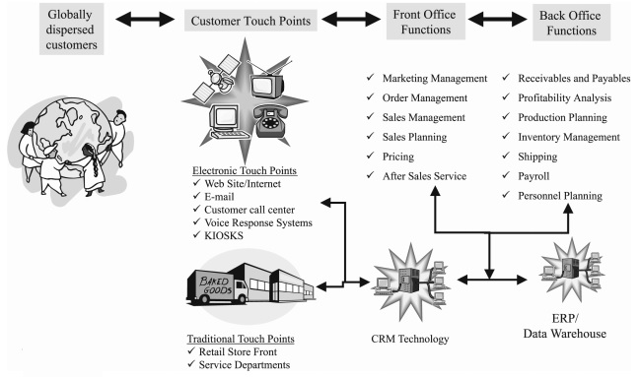
2. e-CRM Tools and Scope
In terms of Information Technologies, the main tools of E-CRM are:
Instant customer assistance support
E-Mail Management
Search engine
Multi-Language Customer Support
Content Management
The E-CRM system includes the following activities:
Sales and Order management from business to business (B2B) or business to customer (B2C)
Online Sales Platform
Web Catalog Management
Information Security Systems
Communication systems for re-communicating with the customers such as conference communication system, automatic response system, e-mail communication, customer service, marketing automation, multilingual support
Figure 1. CRM applications link customer touch points to front and back office functions
Source: Understanding customer relationship management People, process and technology, Chen and Popovich, 2003

Slide 4
3. Benefits of e-CRM
3.1. Cost Reduction and Better Efficiency
Data analysis is extremely important for e-CRM. By using data analysis, companies can save valuable relationships between set of data (whatis.com, 2001; Electronic Customer Relationship Management: Benefits Considerations, Pitfalls and Trends, Scullin et al.). Moreover, customer data can be integrated to single database. In this way, it can allow marketing teams and other departments in company to work toward common goals by using the same statistics (ephany.com 2001; Electronic Customer Relationship Management: Benefits Considerations, Pitfalls and Trends, Scullin et al.). E-CRM can also reduce customer service costs by enabling self-service features such as search functions and order delivery status (bdc.ca, Business Development Bank of Canada, E-commerce for retail: The benefits of using a CRM system).
3.2. Increased Customer Loyalty and Improved Customer Service
E-CRM collects customer information and stores it in a central repository. This situation enables company to meet customers` needs easily. E-CRM provides some technologies such as instant helpdesk, search engines, e-mail management, content management and multi-language support. With e-CRM systems, company can:
-Receive, update and close order remotely more properly.
-Provides access to proven solutions.
-Subscribe to product-related information and software patches (peoplesoft.com, 2001; Electronic Customer Relationship Management: Benefits Considerations, Pitfalls and Trends, Scullin et al.).
Personalization is very important tool for implementing for customer loyalty (Waltner, Charles “CRM makes on-line Shopping Personal”, InformationWeek, 2001; Electronic Customer Relationship Management: Benefits Considerations, Pitfalls and Trends, Scullin et al.). The personalization concept is a timesaving mechanism that drives the advertising and content displayed on a web site based on customer interest. Personalization software tools use data from many sources such as customer database, transaction systems. Thus, it can create real-time profiles for each customer. Personalization is very effective on business-to-business sites (Greenberg, Paul, Capturing and Keeping Customers in Internet Real Time, McGraw-Hill,2001; Electronic Customer Relationship Management: Benefits Considerations, Pitfalls and Trends, Scullin et al.).
For example, every Amazon customer gets personal recommendations for books based on Amazon’s personalization technology (Kennedy, 2006).

Slide 5
3. Benefits of e-CRM
3.3. More Effective Marketing
In a competitive marketplace, firms have to work hard to have any added value. They have to work with customers and to discover ways to run the business more efficiently for themselves and more effective for the customers. Therefore, companies have to become much more active and strategic in order to accomplish customers’ satisfaction (Sunny and Abolaji, 2015).
Grouping customers according to their need similarities allows a company to effectively market specific products to members of the targeted groups.

Slide 6
4. Key factors in Implementing e-CRM
Implementing a successful strategy of CRM in companies depends on the three key factors:
Implementation of New Technologies: CRM implementation requires some changes in the organization’s infrastructures and implementing new technologies such as new business rules, databases, information technology, etc.; these changes lead to useful and effective changes in the organization.
Training of Employees: In the field of interaction and contact with customers, employees must pass some specialized and practical training courses in order to effectively communicate with customers and gain the ability to use new technologies.
Review the Processes and Design New Processes: Firms without logical design of the processes cannot achieve to their goals. Firms must define their business needs and goals first and then in order to achieve to these needs and they must improve and develop the processes associated with CRM. Re-engineering of the business processes is one of efficient tools in this sector (Mohammadi, 2013).

Slide 7
5. Challenges in e-CRM and Solutions
Some of the challenges in implementing e-CRM and how to cope with them are as follows:
Poor Understanding of Commercial Process: Before purchasing of e-CRM, all commercial process of organization has to be controlled.
Weakness in the Software Producer Company: Before purchasing of e-CRM software for organization, software producer should be evaluated to ensure that producer company can continue its business life. Since, in future, e-CRM software company must support company.
Project Size: If there is no appropriate economic condition in the market, the first implementation of a small trail e-CRM system seems to be reasonable.
Lack of Technical Knowledge: In some cases, the cost and time of implementing an e-CRM can rise and it tires the customers. Therefore, simultaneous attention to the customer and technology seems to be effective in the success of these projects (Jarahi, M.H., Saeida Ardakani, S., Zareian, M., (2009), "The role of IT in the e-CRM establishment" Journal of parks and growth centers, Vol.6, No. 21, pp. 49-59; Tavana et al, Electronic Customer Relationship Management and Its Implementation in Business Organizations, 2013.)

Slide 8
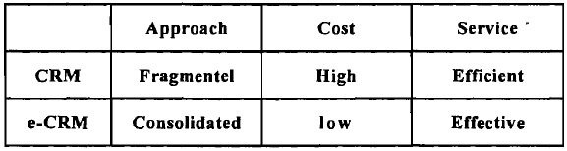
6. Distinction Between CRM and e-CRM
The distinction is made between CRM and e-CRM, based on three parameters of Approach, Cost, and Service (Jafarnejad et al. 2007)
Approach: It means that CRM tries to make full use of many different channels to reach the customer. Therefore, CRM has the fragmented view of each customer across different channel. In other words, the same customer is viewed differently when seen from different channel perspectives. On the other hand, e-CRM has the consolidated approach that integrate all different channels to reach the customers. This concept makes the channel integration possible, i.e whether a customer interacts through Telephone, Fax. E-mail or any other communicate channel, it is seen as a same customer throughout the way (Jafarnejad et al. 2007).
Cost: Cost is the major factor for which organizations are always worried. The overall cost of CRM is high, because different channels must be supported separately by organization. However, organizations can reduce communications costs by using e-CRM that based on internet infrastructure (Jafarnejad et al. 2007).
Service Parameter: CRM is using different channels to communicate with the customers, and it gives us an efficient service. Because an organization cannot see the consolidated view of a customer, therefore not so much value is created for both the customers and organization when a customer interacts with the company. Efficiency is doing the things right. In CRM, it is concern that customer while interacting with the company is treated well, and customers’ needs to be solved in a right way. It is difficult job in CRM to think of personalized service. Effectiveness means that doing the right things. Besides, e-CRM give us a personalized services so that more value is created for both the customers and company and e-CRM wants to make effective use of web channels (Jafarnejad et al. 2007).
Table 2: Shows the difference between CRM and e-CRM
Source: Source Asif et al, 2004

Slide 9
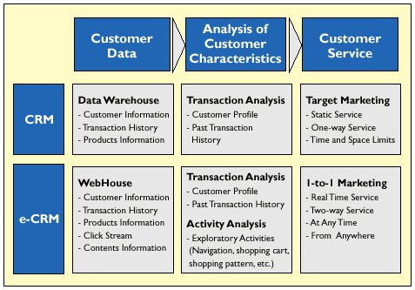
6. Distinction Between CRM and e-CRM
Table 3: The difference between CRM and e-CRM
Source: Pan, S. and Lee, J.,"Using E-CRM for A Unified View of the Customer”, COMMUNICATIONS OF THE ACM April 2003, pp.95-99; Harb and Abu-Shanab, Electronic Customer Relationship Management (e-CRM) in Zain Company, 2009, w.p.

Slide 10
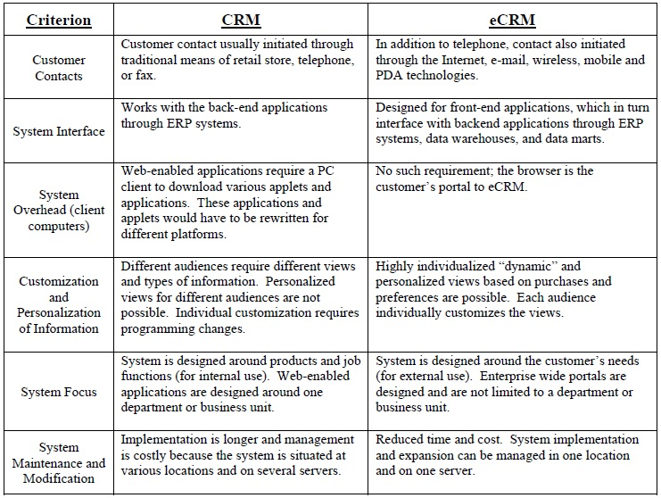
7. Technological Differences between CRM and e-CRM
Table 4: Technological Differences between CRM and e-CRM
Source: Technological differences between CRM and E-CRM, Chandra and Strickland, 2004, p.412.

Slide 11
8. Conclusion
Customers are always interested in the quality of products and in how quickly companies can meet their needs. In recent years, internet technology has developed very rapidly. It is extremely important that internet technologies be used in customer relationships. Because internet technologies reduce the costs of firms, enable more customers to reach by providing globalization capabilities. Customers are always at the center of the policies of the companies. For this reason, companies need to understand the CRM and e-CRM philosophy in order to increase their profits and income.

Slide 12
References
Chaffey, D. E-Business and E- Commerce Management, Prentice Hall (Pearson Education Limited), 2007; Harb& Abu-Shanab, Electronic Customer Relationship Management (e-CRM) in Zain Company.
Feinberg, R. A., Kadam, R., Kokama, L. and Kim, I., The state of electronic customer relationship management in retailing, International Journal of Retail & Distribution Management, Vol. 30, No. 10 pp 470-481, 2002; Osama K. Harfoushi, Electronic Customer Relationship Management Usability Model: Improving the Usability of eCRM Systems in Jordan.
Greenberg, Paul, Capturing and Keeping Customers in Internet Real Time, McGraw-Hill,
Harfoushi , Electronic Customer Relationship Management Usability Model: Improving the Usability of eCRM Systems in Jordan, 2003.
http://www.ephany.com/market/crm_benefits.html 2001; Electronic Customer Relationship Management: Benefits Considerations, Pitfalls and Trends, Scullin et al.
http://www.peoplesoft.com/en/us/products/applications/crm/product_content.html 2001; Electronic Customer Relationship Management: Benefits Considerations, Pitfalls and Trends, Scullin et al.
Jafarnejad et al, toward e-CRM: An e-CRM Solution Development Methodology, 2007.
Jarahi, M.H., Saeida Ardakani, S., Zareian, M., (2009), "The role of IT in the e-CRM establishment" Journal of parks and growth centers, Vol.6, No. 21, pp. 49-59; Tavana et al, Electronic Customer Relationship Management and Its Implementation in Business Organizations,2013.

Slide 13
References
Kennedy, Electronic Customer Relationship Management (eCRM): Opportunities and Challenges in a Digital World, 2006.
Mohammadi, E., (2003), "Customer oriented", Rasa publication, Tehran; Tavana et al, Electronic Customer Relationship Management and Its Implementation in Business Organizations, 2013.
Sunny and Abolaji , Electronic Customer Relationship Management (E-CRM) & Marketing Performance: Empirical Evidence from Nigeria Telecom Sector, 2015.
Waltner, Charles “CRM makes on-line Shopping Personal”, InformationWeek, 2001; Electronic Customer Relationship Management: Benefits Considerations, Pitfalls and Trends, Scullin et al
Wang MY. Measuring E-CRM service quality in the library context: A preliminary study. The Electronic Library. 2007;26(6): 896-911; Sunny and Abolaji, e-CRM & Marketing Performance: Empirical Evidence from Nigeria Telecom Sector.
whatis.com, 2001; Electronic Customer Relationship Management: Benefits Considerations, Pitfalls and Trends, Scullin et al.

